Slide 1

PizzaHut Sales Analysis using SQL
By -
Atharva Patkar

Slide 2



Hello,I am Atharva Patkar. In this project,I have analyzed the PizzaHut Sales using some SQL questions related to the data.So,we can see the queries and their respective results in further slides of presentation

Slide 3


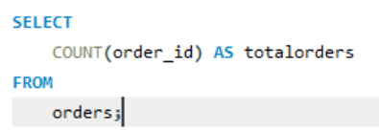
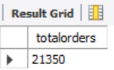

Retrieve the total number of orders placed.

Slide 4
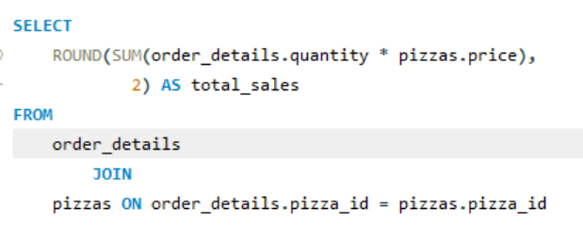
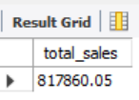
Calculate the total revenue generated from pizza sales

Slide 5
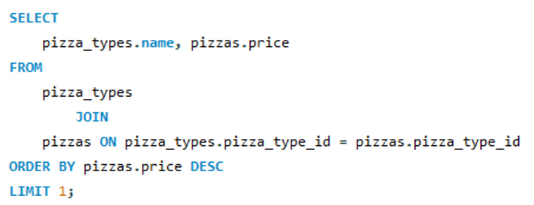
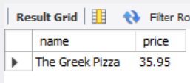
Identify the highest-priced pizza.

Slide 6
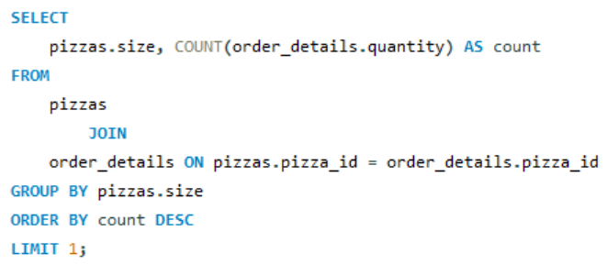
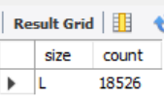
Identify the most common pizza size ordered.

Slide 7
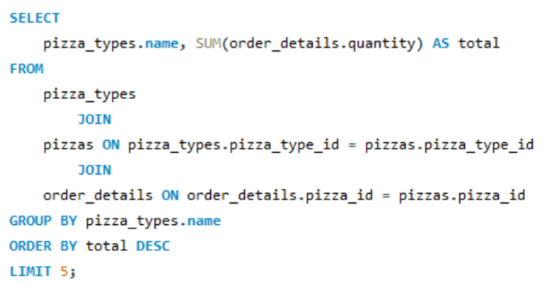
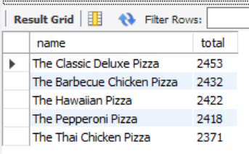
List the top 5 most ordered pizza types along with their quantities.

Slide 8
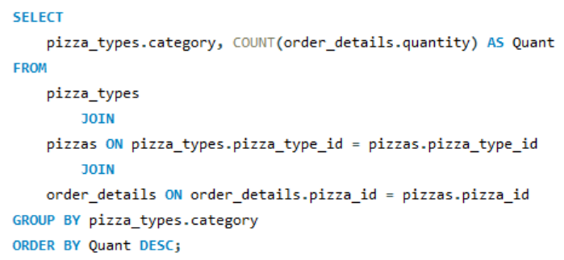
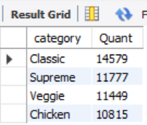
Join the necessary tables to find the total quantity of each pizza category ordered.

Slide 9
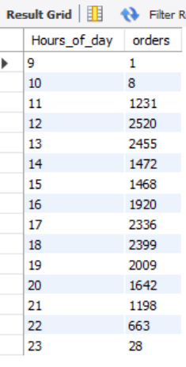
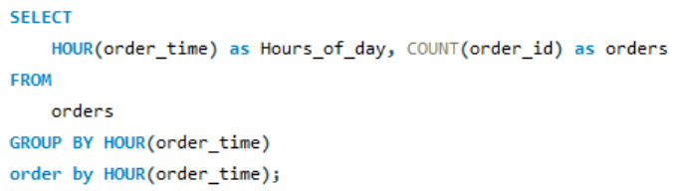
Determine the distribution of orders by hour of the day.

Slide 10
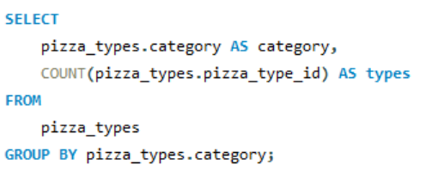
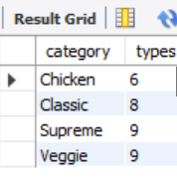
Join relevant tables to find the category-wise distribution of pizzas.

Slide 11
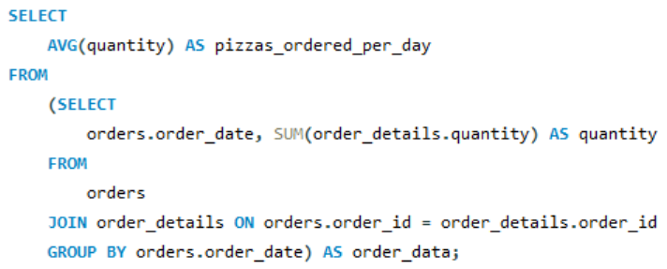
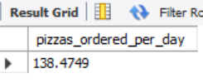
Group the orders by date and calculate the average number of pizzas ordered per day.

Slide 12
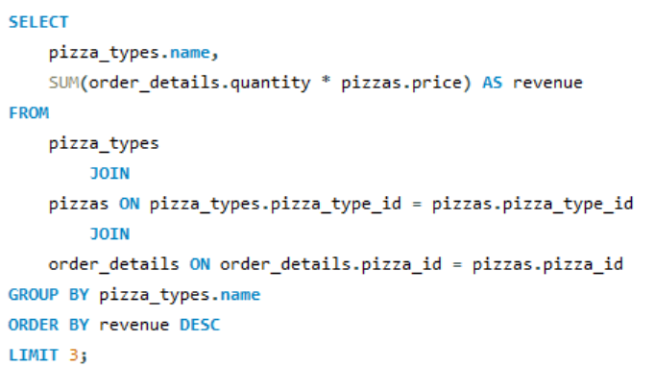
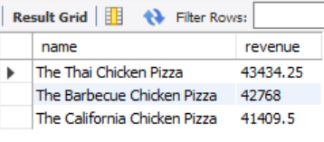
Determine the top 3 most ordered pizza types based on revenue.

Slide 13
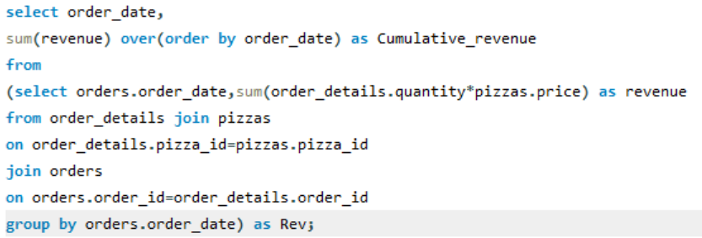
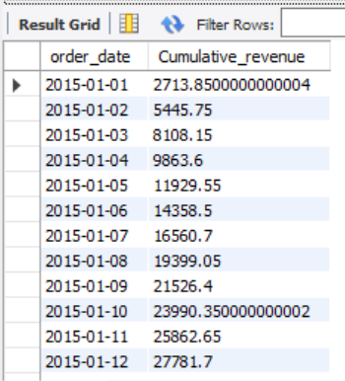
Analyze the cumulative revenue generated over time.

Slide 14
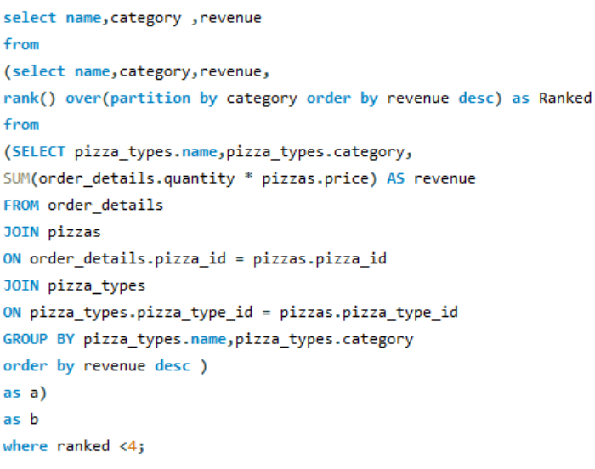
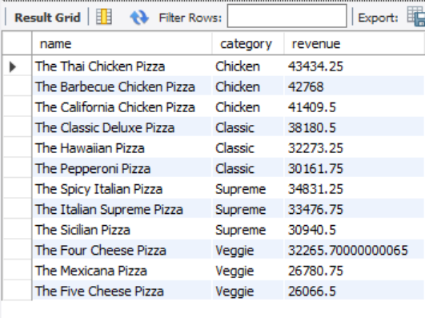
Determine the top 3 most ordered pizza types based on revenue for each pizza category.

Slide 15

Thank You

